Slide 1

Angular
Josh Vlasin

Slide 2
Today’s Topic
Overview of Angular
How to install angular cli
How to generate a new angular project
How to generate components (Header, footer, content, page)
Link routing to page components
Brief showcase of finished project

Slide 3
What is Angular?
Front-end web application framework used to build websites.
Created and maintained by Google
Uses TypeScript which is a superset of JavaScript
Open Source

Slide 4
Key Features
Component-Based Architecture – UI is built using reusable components
Built-in Routing – Easy to create navigation within application
Powerful CLI – Makes development tasks easier (Generation, Building, etc.)

Slide 5
Step 1
Install Node and NPM for your system: https://nodejs.org/en/download
Install Angular CLI (After installing Node and NPM):
npm install -g @angular/cli

Slide 6
Step 2 – Generate Application
Open terminal and navigate to folder of choice
ng new <application name of choice>
Open app in IDE of choice

Slide 7
Component Structure
example-component.css – component-specific stylesheet
example-component.html – defines the user interface for the component
example-component.spec.ts – contains test for corresponding ts file, ensures that component behaves and functions as expected
example-component.ts – contains core logic, behavior, and data of component

Slide 8
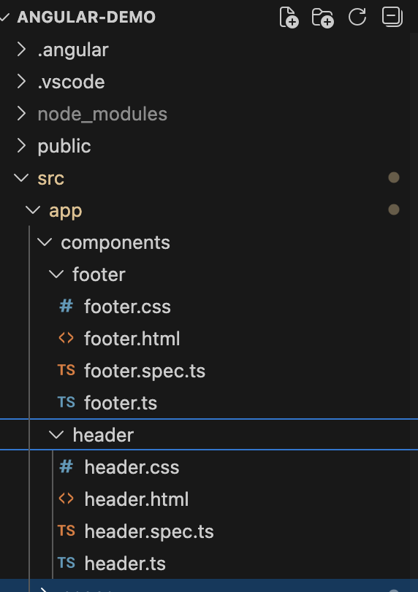
Step 3 – Generate Components
Open terminal and navigate to the root of project folder
cd PATH/TO/angular-project
ng generate component components/header
ng generate component components/footer
^ creates a components folder under app folder that houses components

Slide 9
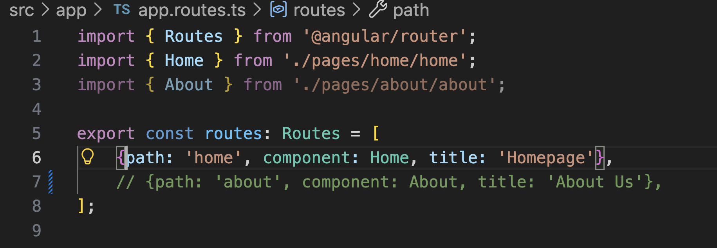
Step 4 – Generate Pages
ng generate component pages/home
ng generate component pages/about
Open app.routes.ts and link the page components:

Slide 10
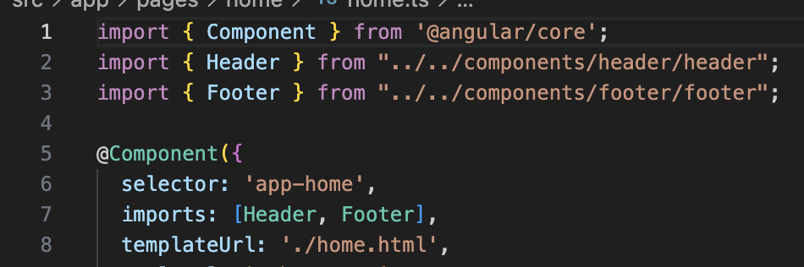
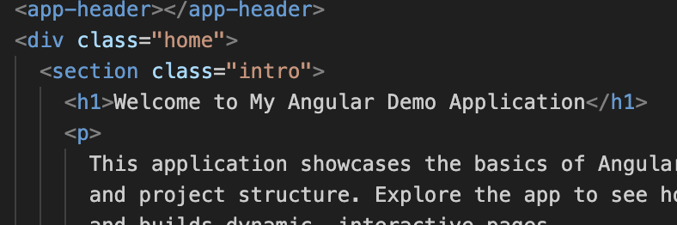
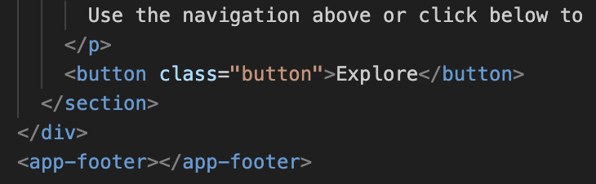
Last step – Use components

Slide 11
Demo Time

